Slide 1
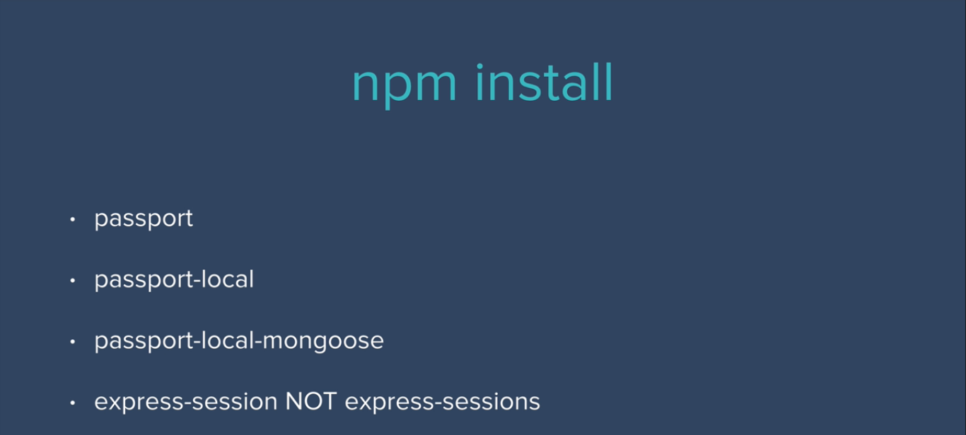
Installing necessary packages in secrets project one by one

Slide 2
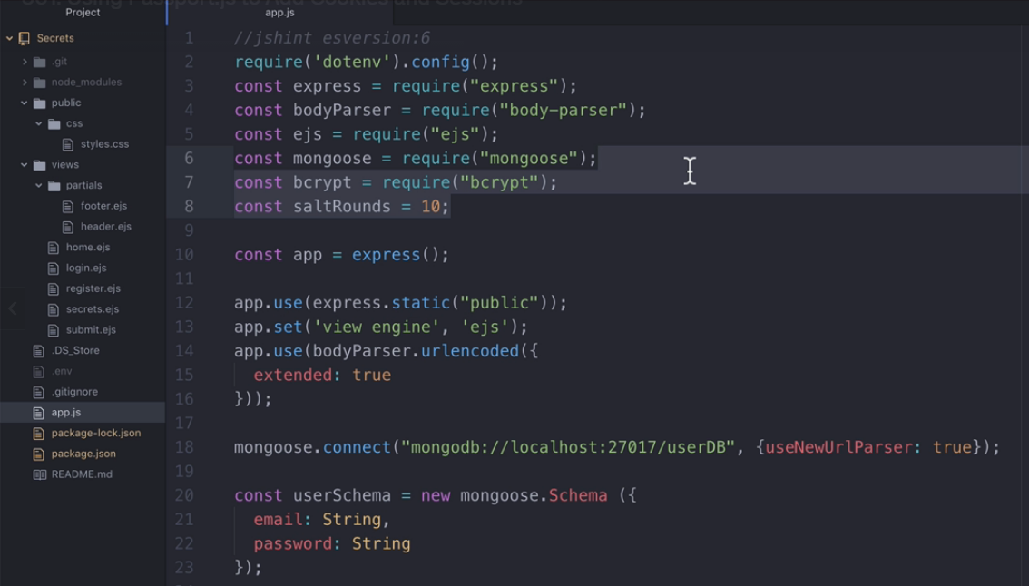
Removing previous bcrypt code at line no 7 & 8

Slide 3
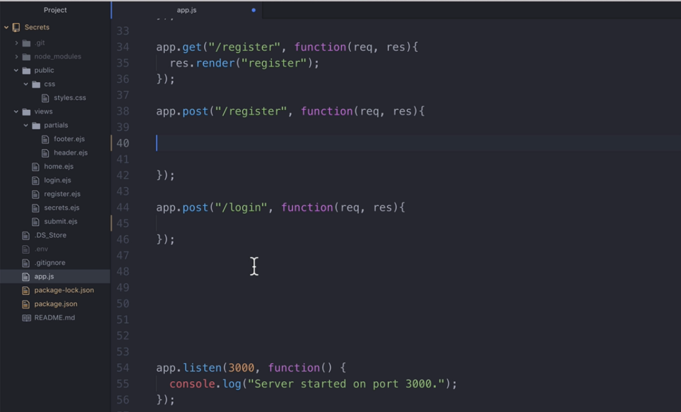
Removing previous codes at register & login routes

Slide 4
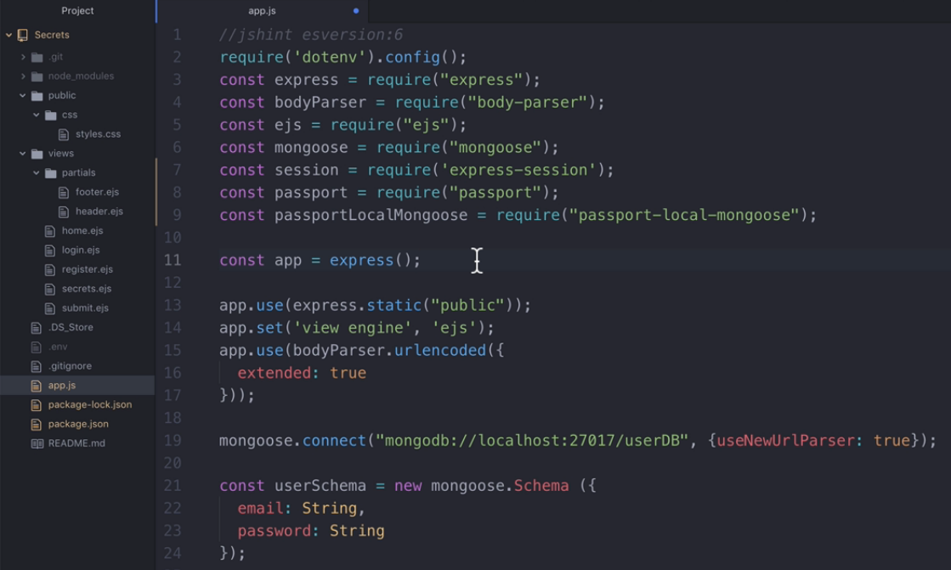
Importing all new installed packages export passport-local

Slide 5
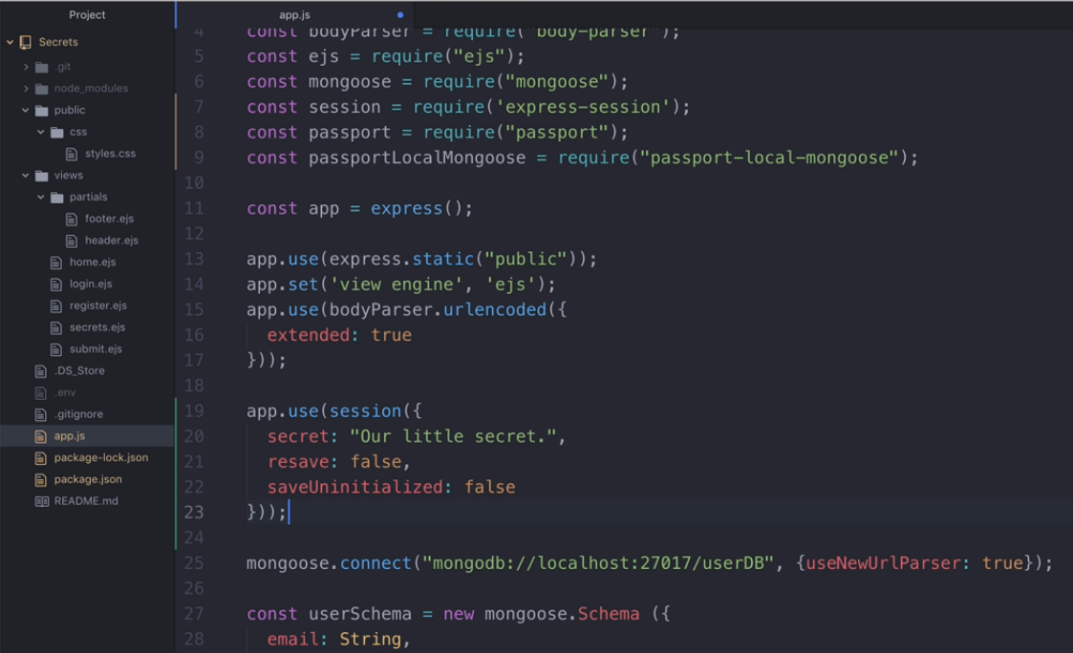
Setting up session inside app.use, before mongoose connect method

Slide 6
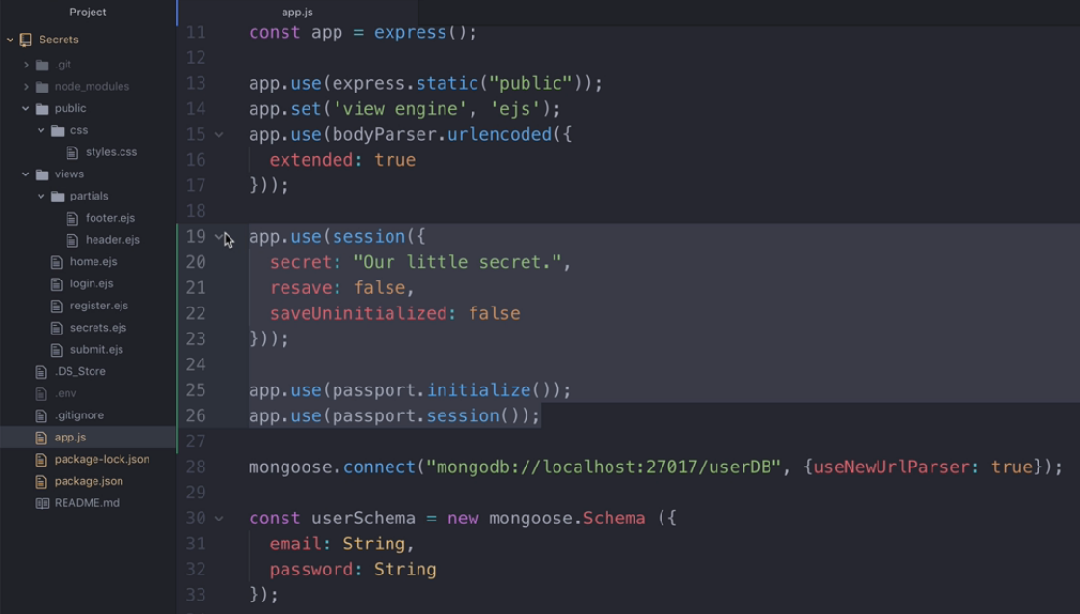
Setting up passport inside app.use, before mongoose connect method

Slide 7
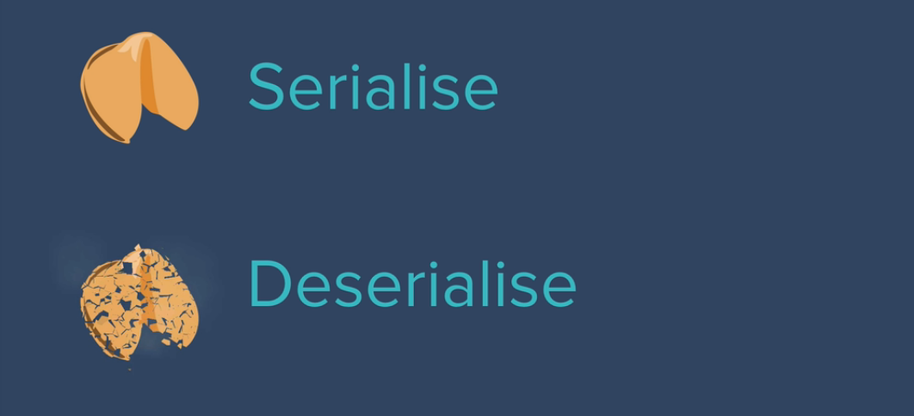

Slide 8
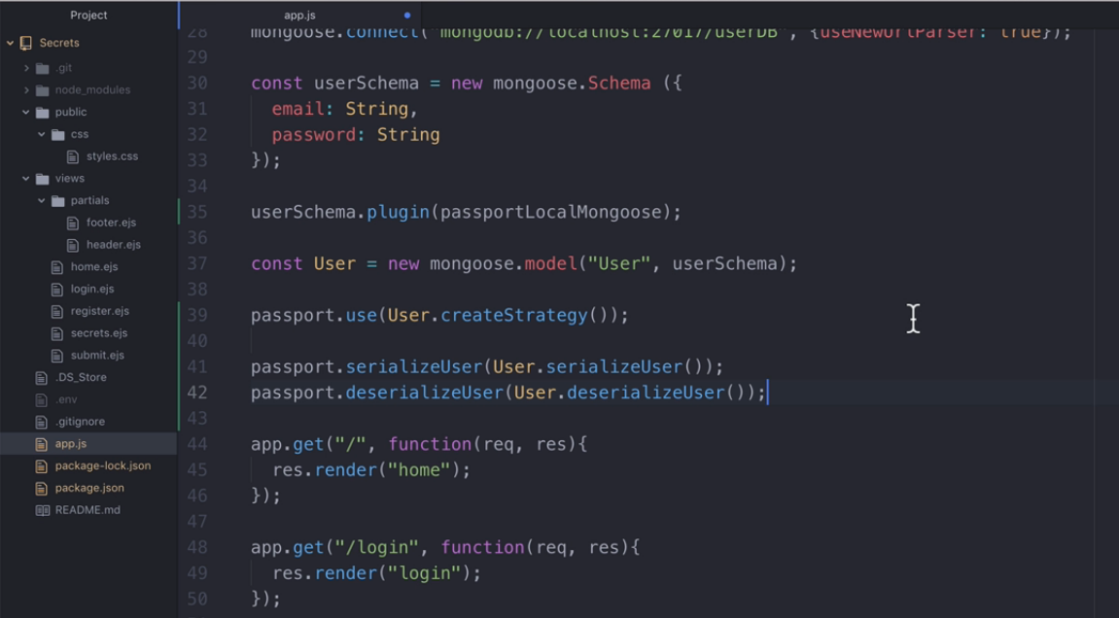
Setting up userSchema plugin & Serialize - Deserialize

Slide 9
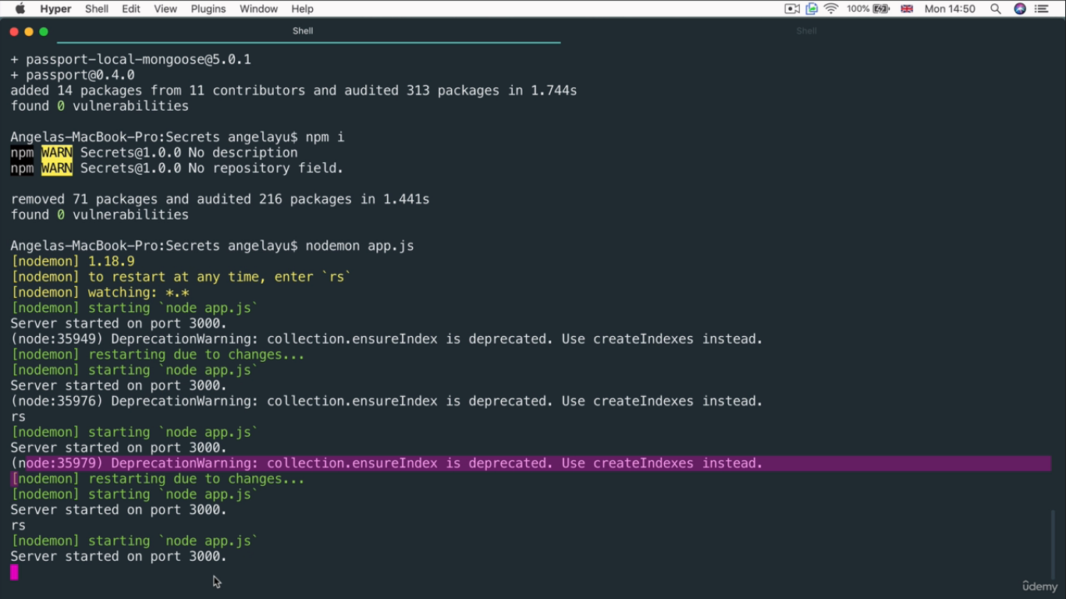
To avoid warning /error messages, Copy and paste that line
At Google / that particular package GitHub home page to get
Right solution to that issues.

Slide 10
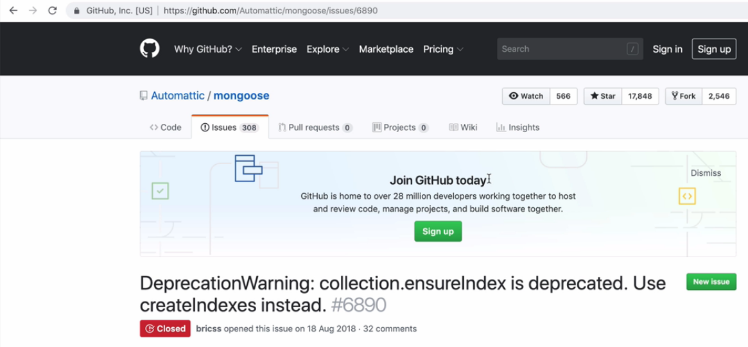
Solutions: You may get other developer help message to solve issues

Slide 11
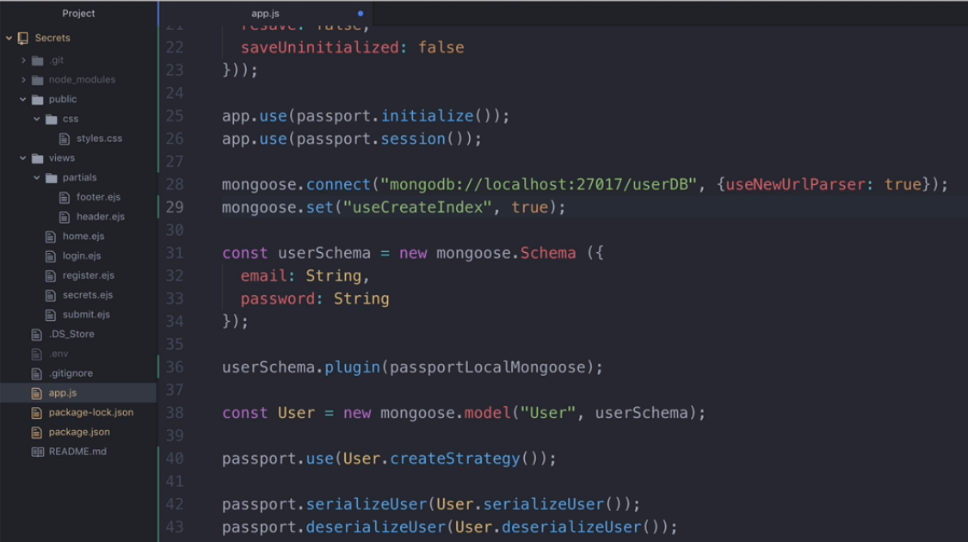
Finding solution at Google and adding that line to avoid warning /error messages

Slide 12
Again run the application

Slide 13
We have done all configuration settings successfully,
Now it is time to write code to perform register & login
Process. We are going to use passport-local package which
is running in background after installation.
(No external import is required)

Slide 14
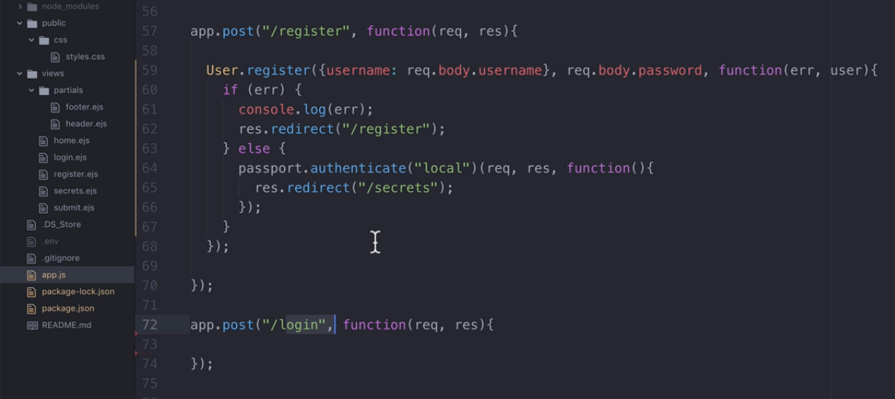
Writing code at Register Route: Adding passport local authentication.

Slide 15
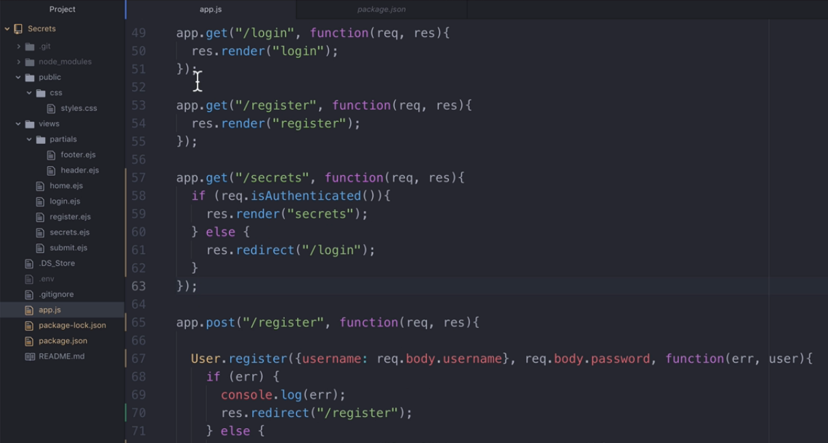
Create secrets get route : Check user authentication or not.

Slide 16
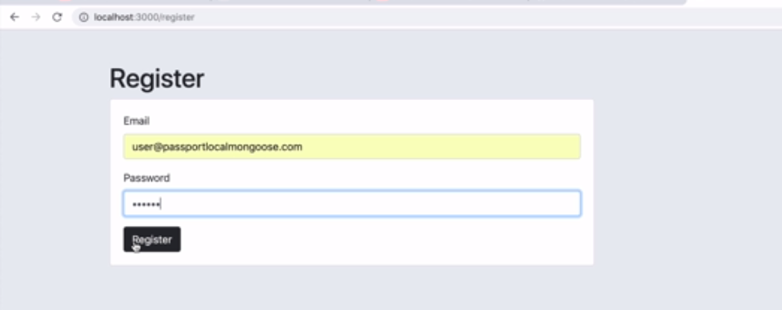
Register Route

Slide 17
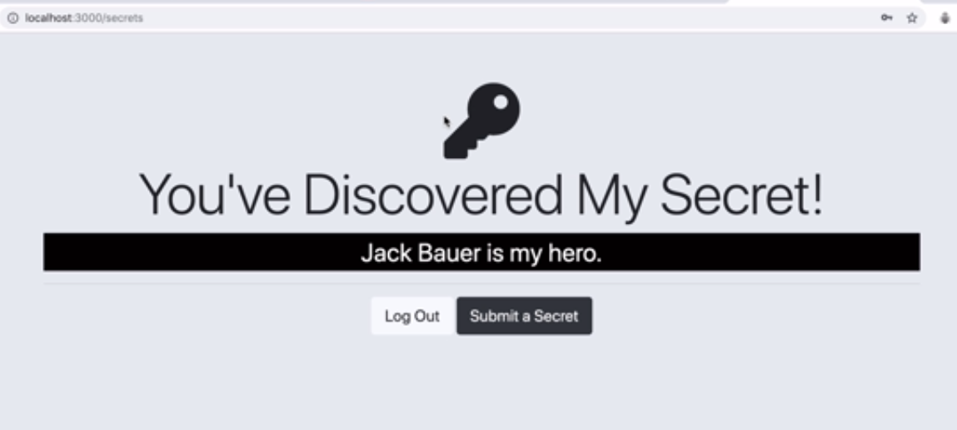
Register Route: Successful Page

Slide 18
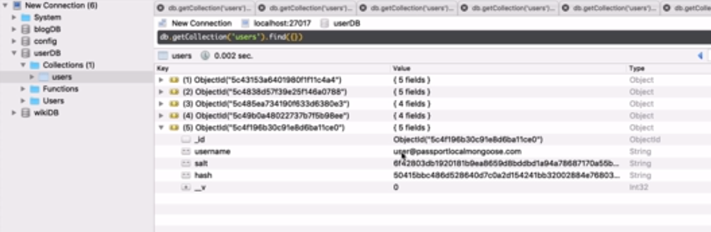
Checking at DB -Collection

Slide 19
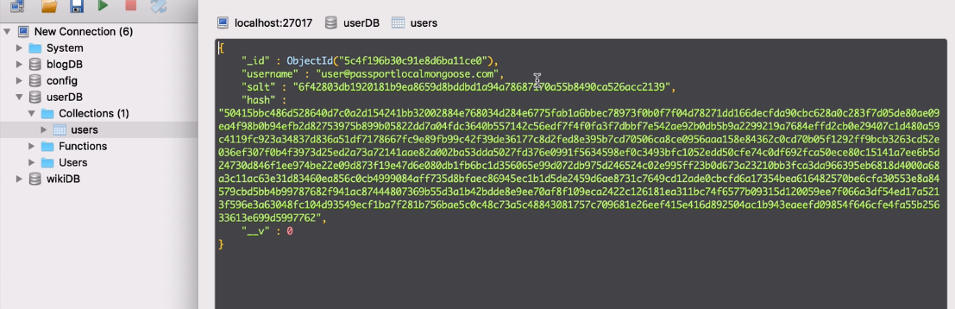
Automatically hash & Salt Created and Stored in DB

Slide 20
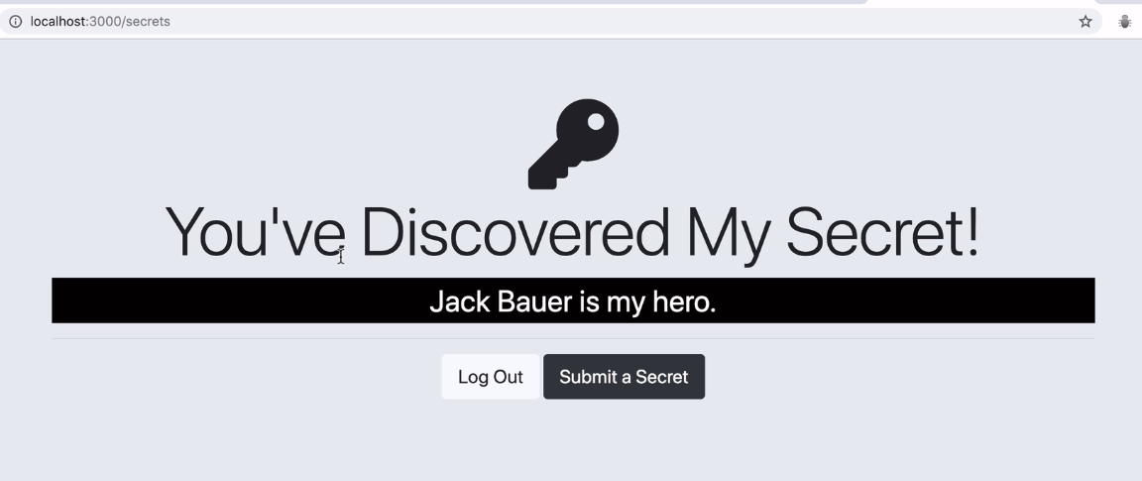
If we access secrets route directly then it allows to access.
Because cookies are stored in web browser

Slide 21
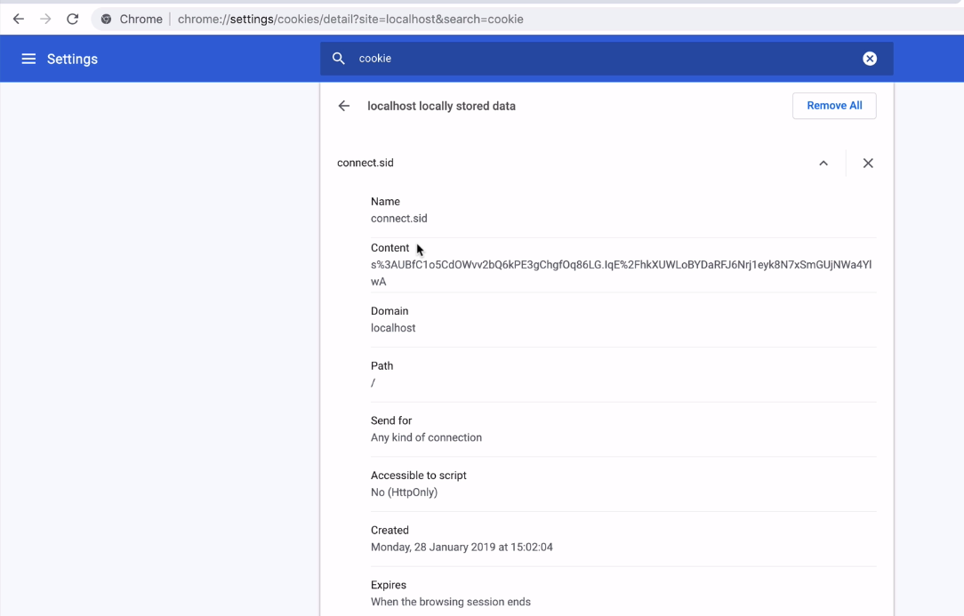
Checking any cookie stored in web browser using settings

Slide 22
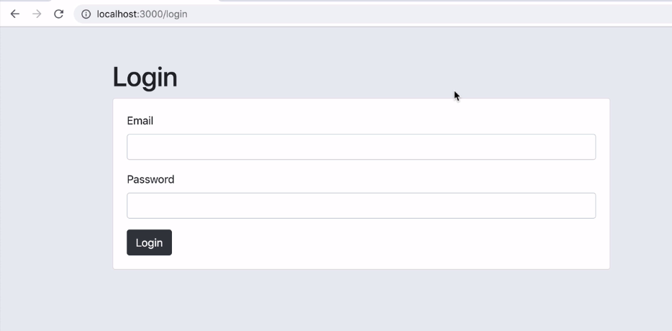
If we try to access secrets route after closing a browser
then it redirects to login page

Slide 23
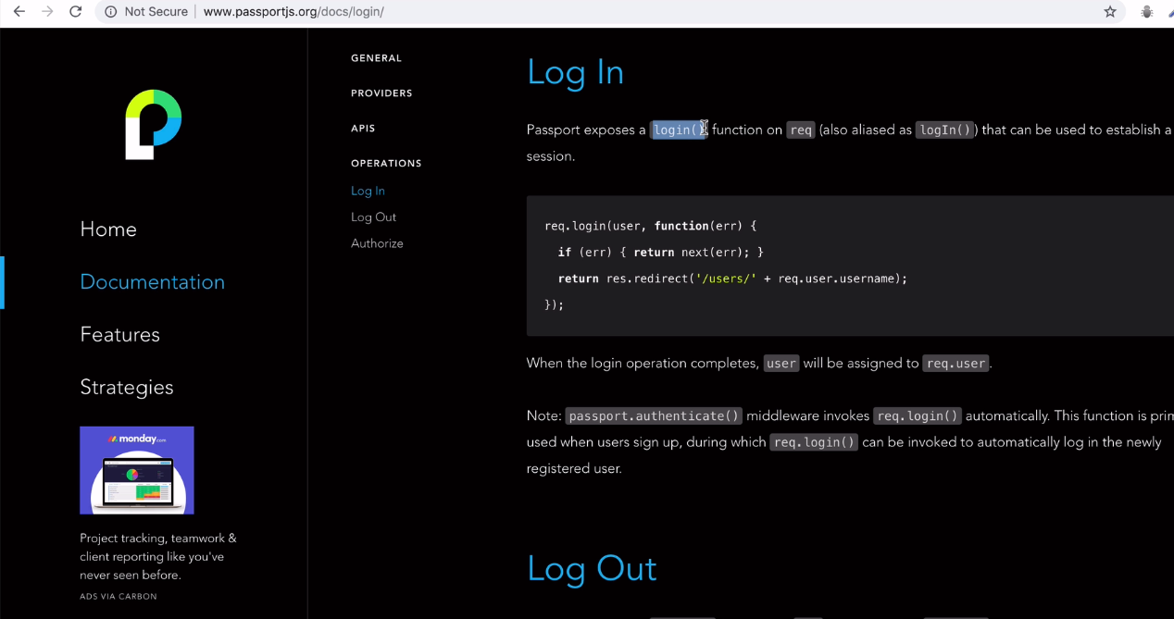
Documentation page of passport.js : Login

Slide 24
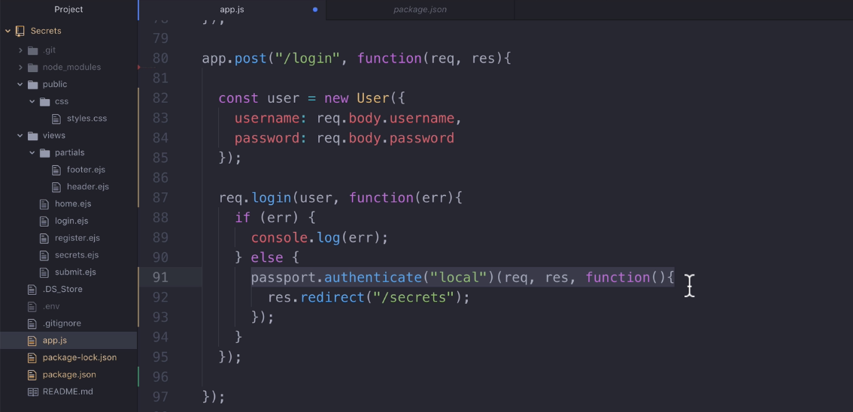
Adding Login Route Code

Slide 25
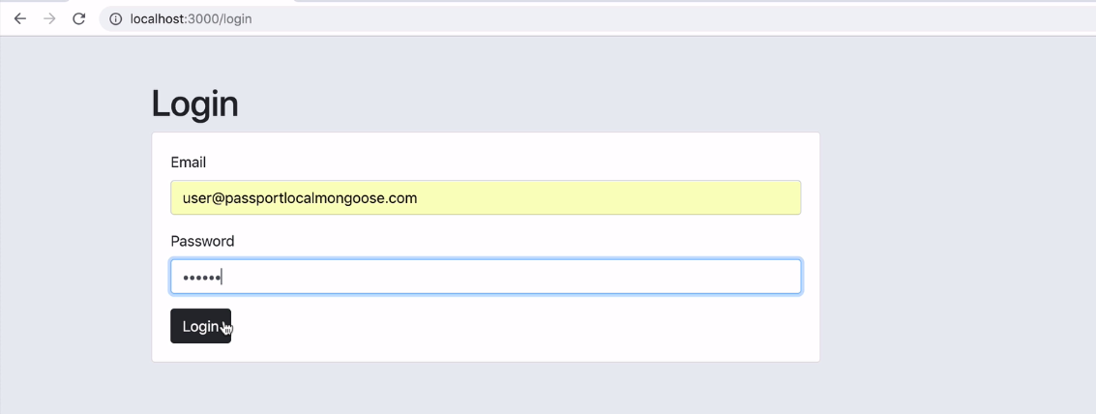
Login Route

Slide 26
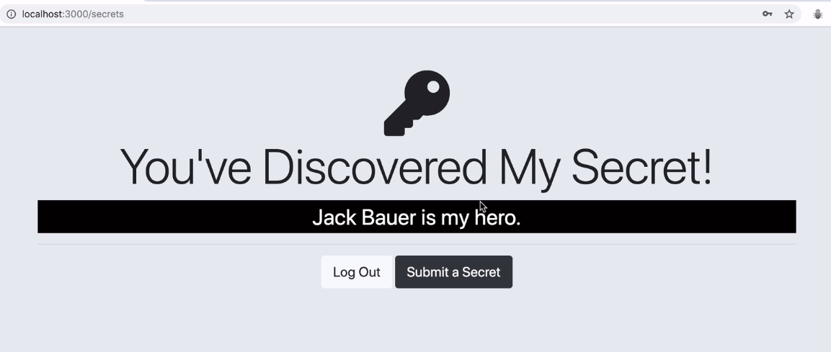
Login Route: Successful Page

Slide 27
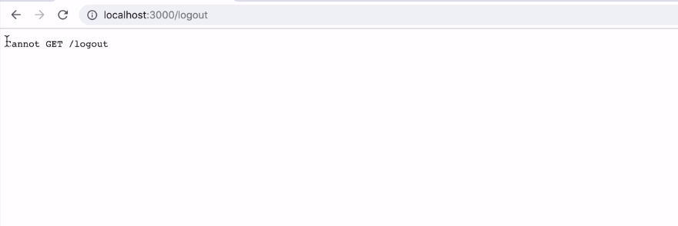
Logout Route not yet defined

Slide 28
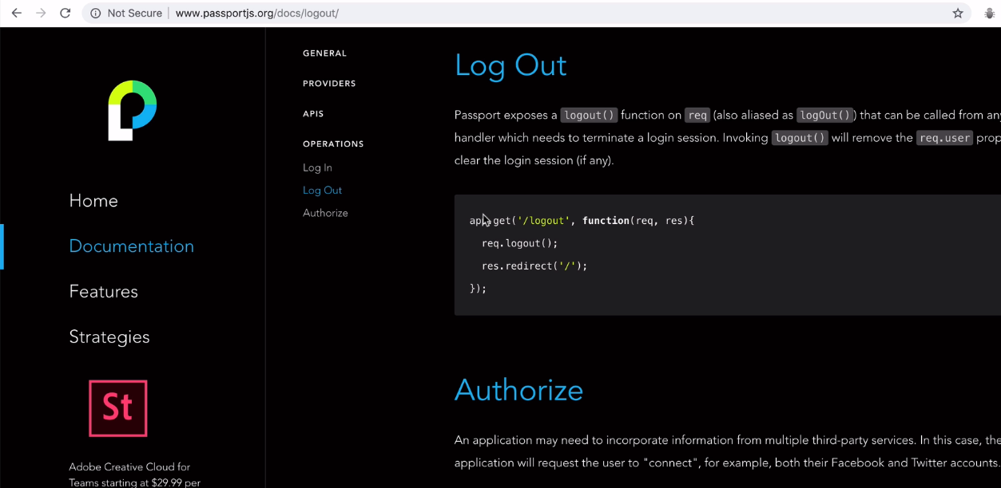
Documentation page of passport.js : Logout

Slide 29
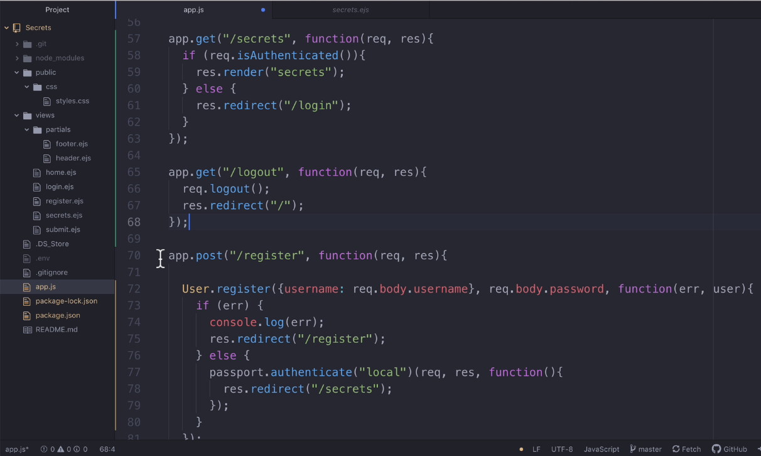
Logout Route Code

Slide 30
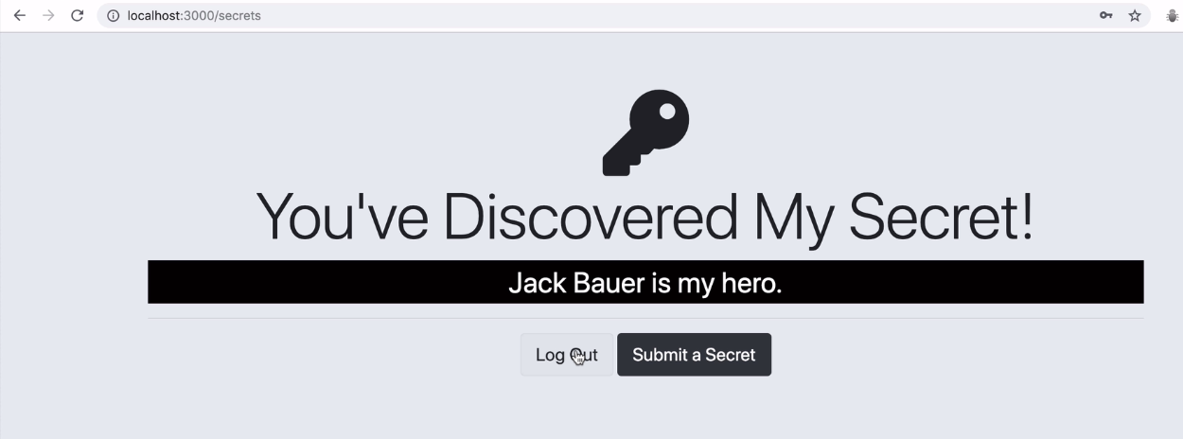
Clicking Logout Button after Login

Slide 31
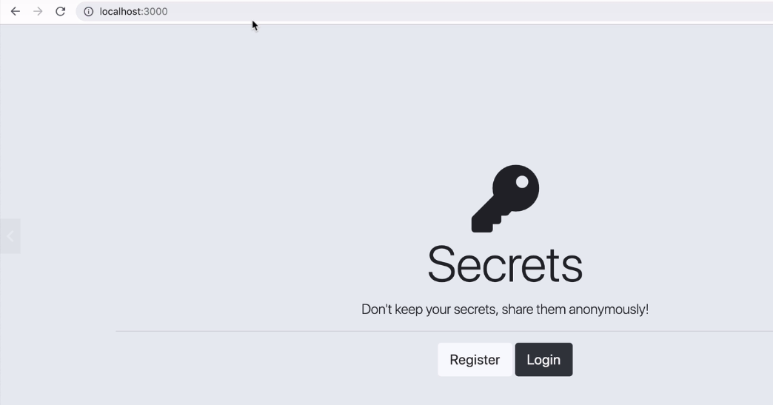

Slide 32
Remember: If we do any update in our code then nodemon will restart Our code so cookies will be deleted and we can not access Secrets page.

